Slide 1
uv, Alembic, Pydantic, & FastAPI

Slide 2
This project/demo assumes Postgres in Docker:
docker run --name local-postgres \
-e POSTGRES_USER=postgres \
-e POSTGRES_PASSWORD=Password123! \
-e POSTGRES_DB=student_tracker \
-p 5432:5432 \
-d postgres:17

Slide 3
UV
uv is a fast Python package and project manager from Astral. It can replace much of the functionality of pip, venv, pip-tools, pyenv, pipx, and parts of Poetry or virtualenv workflows with a single tool.
The most useful way to learn uv is to think of it as managing four things:
  Python versions — install and select Python interpreters.
  Dependencies — add, remove, resolve, and install packages.
  Projects and environments — manage pyproject.toml, virtual environments, and lockfiles.
  Tools and scripts — run Python scripts, CLI applications, and one-off commands without manually setting everything up.

Slide 4
uv setup
On macOS or Linux:
curl -LsSf https://astral.sh/uv/install.sh | sh
On Windows PowerShell:
powershell -ExecutionPolicy ByPass -c "irm https://astral.sh/uv/install.ps1 | iex"

Slide 5
uv commands
uv --version — check the installed version.
uv help — see the main command groups.
uv help sync — view help for a particular command.
uv self update — update a standalone installation of uv; availability depends on how you installed it.
uv init my-project – Create a new uv-managed project with a pyproject.toml file
uv add requests – Add a dependency to pyproject.toml
uv add --dev pytest – Add a dev dependency to pyproject.toml
uv remove requests – Remove a dependency from pyproject.toml
uv sync – Update the project to match the pyproject.toml dependencies

Slide 6
uv commands – continued
uv python list – List installed python versions
uv python install 3.13 – Install a specific python version
uv python pin 3.12 – Pin your project to a certain version
uv venv --python 3.12 – Create a venv in your project with a certain version
uv run – Run the python app or other tools (such as alembic for migrations)
uv build – Produce build artifacts for the project

Slide 7
Packages
Pyproject.toml new dependencies:
Sqlalchemy - maps python objects to database tables
Psycopg[binary] - driver to communicate with postressql
Sqlalchemy-utils - misc utilities
Alembic - managed db schema migrations
Python-dotenv - work with env variables
Fastapi - routes HTTP request to python code
Uvicorn - runs your web app and handles network traffic
Pydantic - provides serialization, DTO-like functionality

Slide 8



Alembic
Initializes alembic files in the project
Generates a single migration
Applies migrations to the DB

Slide 9
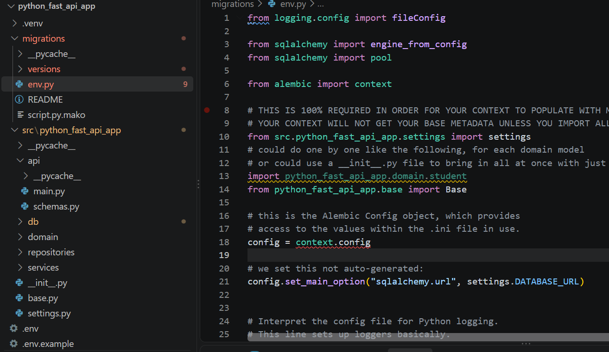
Alembic - env.py
The env.py file setups alembic to connect to our DB using a local environment variable
Our ‘settings’ import retrieves our environment variables

Slide 10
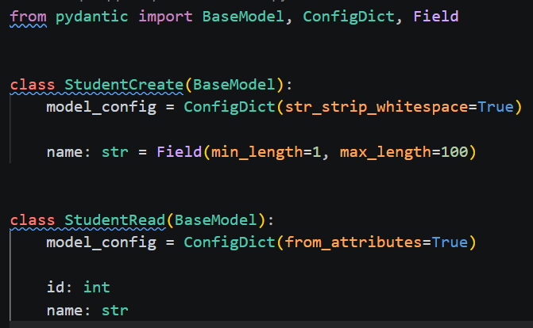
Pydantic
Pydantic is the most widely used data validation and settings management library in Python. It enforces type hints at runtime, ensuring that the data flowing through your application matches the expected schema and structure
It’s dual purpose! DTO-like functionality + data validation!
api/schemas.py:

Slide 11
FastAPI
FastAPI is a modern, high-performance Python web framework used to build APIs (Application Programming Interfaces). It is particularly popular for developing REST APIs, microservices, backend systems, and AI/ML application backends.
  High performance: Supports asynchronous programming using async and await.
  Automatic API documentation: Generates interactive Swagger UI and ReDoc documentation.
  Data validation: Uses Pydantic to validate request and response data.
  Type hints: Uses Python type annotations to improve code quality.
  Dependency injection: Provides a built-in dependency management system.
  Security support: Supports OAuth2, JWT-based authentication patterns, API keys, and other security mechanisms.
  Easy integration: Works with SQL databases, NoSQL databases, machine learning models, and external services.

Slide 12
FastAPI
FastAPI supports all common HTTP methods:
@app.post("/users")
def create_user():
return {"message": "User created"}
@app.put("/users/{user_id}")
def update_user(user_id: int):
return {
"message": "User updated",
"user_id": user_id
}
@app.delete("/users/{user_id}")
def delete_user(user_id: int):
return {
"message": "User deleted",
"user_id": user_id
}

Slide 13
FastAPI & Pydantic for validation/DTOs
Pydantic is dual-purpose
Data validation + DTOs
from fastapi import FastAPI
from pydantic import BaseModel, Field
app = FastAPI()
class User(BaseModel):
name: str
age: int = Field(gt=0)
email: str
@app.post("/users")
def create_user(user: User):
return {
"message": "User created",
"user": user
}

Slide 14
STOP
Please see ‘python_fast_api_app’ in your course materials for examples
Please see the readme file in the app for instructions
Please see the ‘sqlalchemy-guide.md’ file in the folder for a primer on SQLAlchemy!
Note: this uses SQLAlchemy 2+ syntax for our ORM – domain models will look different compared to SQLAlchemy version 1!

Slide 15
Docker
Docker lets us package apps + its OS level environment into a reproducible box.
Those boxes are called images.
When you run an image you get a container.
A Dockerfile is a recipe for building images.

Slide 16
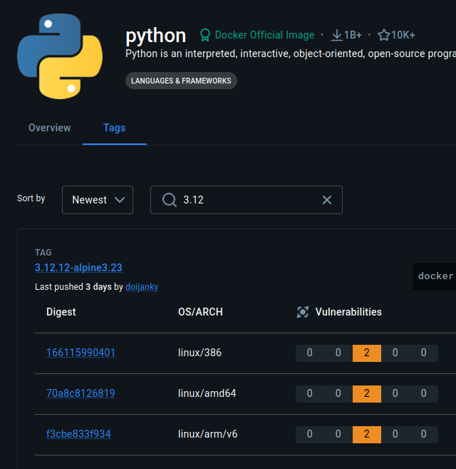
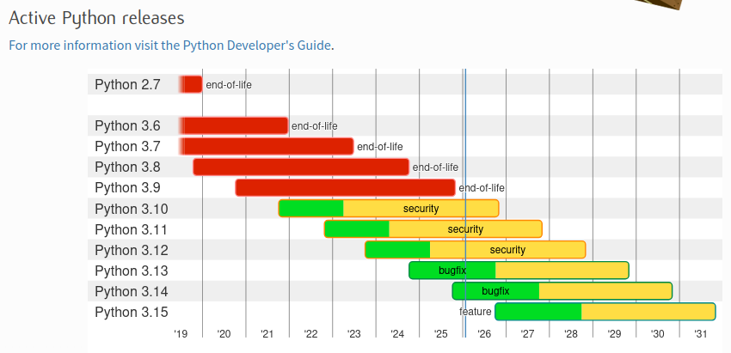
Consider your version
Docker Hub:
Python doesn’t do “LTS” releases.

Slide 17
Single vs Multi-Stage Dockerfiles
Ships Everything: Only ships what’s needed:
FROM node:20
WORKDIR /app
COPY . .
RUN npm install && npm run build
CMD ["npm", "start"]
FROM node:20 AS builder
WORKDIR /app
COPY . .
RUN npm install && npm run build
FROM node:20-slim
WORKDIR /app
COPY --from=builder /app/dist ./dist
COPY --from=builder /app/node_modules ./node_modules
CMD ["node", "dist/index.js"]

Slide 18
Multi-Stage Image - Python App
FROM python:3.12-slim AS builder
WORKDIR /app
RUN apt-get update && apt-get install -y curl build-essential
RUN curl -sSL https://install.python-poetry.org | python3 -
ENV PATH="/root/.local/bin:$PATH"
COPY pyproject.toml poetry.lock /app/
RUN poetry config virtualenvs.create false
RUN poetry install --without dev --no-interaction --no-ansi
ENV PATH="/usr/local/bin:/root/.local/bin:$PATH"
COPY src /app/src
COPY src/repl.py /app/repl.py
COPY alembic.ini /app/alembic.ini
COPY alembic /app/alembic
Stage 1: builder
- Install system deps
- Install Poetry
- Set PATH to Poetry
- Turn off venv generation
- Install Python dependencies
- Add Alembic/uvicorn to PATH
- Copy source code/migrations

Slide 19
Multi-Stage Image - Python App
Stage 2: runtime
- We start with clean Python image - no curl, no build tools, no poetry install script, much smaller
- Copy only built artifacts
- Python Packages
- Source Code
- Poetry Binary
- Run the app
FROM python:3.12-slim
WORKDIR /app
COPY --from=builder /usr/local/lib/python3.12 /usr/local/lib/python3.12
COPY --from=builder /app /app
COPY --from=builder /usr/local/bin /usr/local/bin
ENV PYTHONUNBUFFERED=1
ENV PATH=”/usr/local/bin:/root/.local/bin:$PATH”
CMD ["uvicorn", "src.main:app", "--host", "0.0.0.0", "--port", "8000"]

Slide 20
Docker Compose
Docker Compose is a tool to define and run multi-container applications.
Spin up multiple containers at once
Define dependencies between services
Share environment variables
Manage volumes (persist data between restarts)

Slide 21
Super Ugly Docker Compose Slide :) sorry
services:
app:
build: .
container_name: myapp
env_file:
- .env
#volumes:
# - .:/app
depends_on:
db:
condition: service_healthy
ports:
- "8000:8000"
command: ["uvicorn", "src.main:app", "--host", "0.0.0.0", "--port", "8000"]
db:
image: postgres:15
container_name: mydb
env_file:
- .env
environment:
POSTGRES_USER: ${POSTGRES_USER}
POSTGRES_PASSWORD: ${POSTGRES_PASSWORD}
POSTGRES_DB: ${POSTGRES_DB}
ports:
- "5432:5432"
volumes:
- postgres_data:/var/lib/postgresql/data
healthcheck:
test: ["CMD-SHELL", "pg_isready -U ${POSTGRES_USER} -d ${POSTGRES_DB}"]
interval: 5s
timeout: 5s
retries: 5
volumes:
postgres_data:

Slide 22
First Migration / Build

Slide 23
Other Helpful Commands
alembic upgrade <revision> = Applies migrations up to the specified revision. head applies all pending migrations.
alembic downgrade <revision>
Rolls back migrations. Examples:
  alembic downgrade -1 → step back 1 revision
  alembic downgrade base → go back to the initial state
alembic history = Shows the list of all migrations and their revision IDs.
alembic current = Displays the current revision(s) applied to the database.
alembic heads = Shows the latest revision(s) in the migration tree (useful if you have multiple heads/branches).
alembic branches = Lists any branching points in your migration history.

Slide 24
Logging
Logs help us audit issues
Logs help us audit events
Logs may be required due to compliance
Logs are a good practice
We can print to files (not recommended)
More common: logs print to stderr or stdout
Sys.stderr = Pythons error output stream
Sys.stdout = Pythons normal output stream

Slide 25
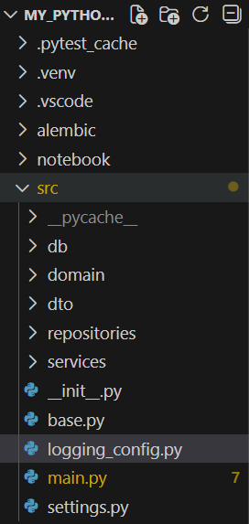
Logging Structure
logging_config.py – sets up our settings for log level and how logs actually print
Default Log Levels in Python logger:
  DEBUG – detailed info, only for development
  INFO – Confirmations things are working
  WARNING – still working as expected, but indication something unexpected happened
  ERROR – Due to a more serious issue, the app was not able to perform a function at all
  CRITICAL – A serious error that may crash the entire app
Mnemonic: DIWEC
Don’t Ignore Warnings Errors are Critical

Slide 26
logging_config.py
setup_logging() – will only run once at startup
level=logging.INFO – means that only INFO messages and more severe will be captured
C-style string formatting is preferred for logs (lazy formatting performance boost)
%()s <- ‘s’ format as string
There is also d=int, f=float, r=repr(), x=hex
Again, we SHOULD NOT print logs to files. Once our app is hosted, host providers typically read from stdout and stderr.
import logging
def setup_logging():
logging.basicConfig(
level=logging.INFO,
format="%(asctime)s - %(levelname)s - %(name)s - %(message)s",
# filename='app.log'
)

Slide 27

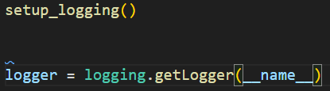

Initializing our setup file (main.py)
setup_logging() is only called once!
But we initiate loggers for each module!
__name__ gets resolved to the module location. Each module gets its own copy (this gives us flexibility later to control what log levels print for each module)
Log automatically shows WHERE it came from!

Slide 28
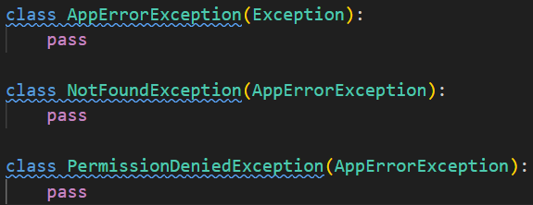
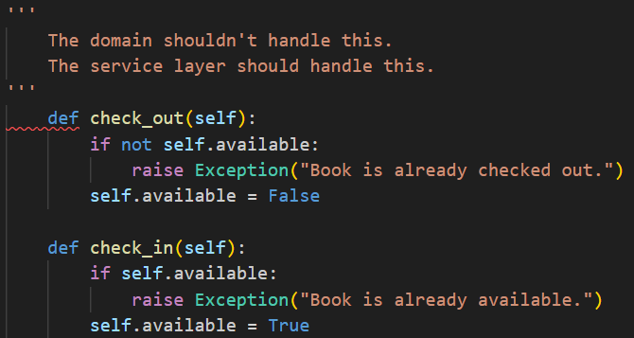
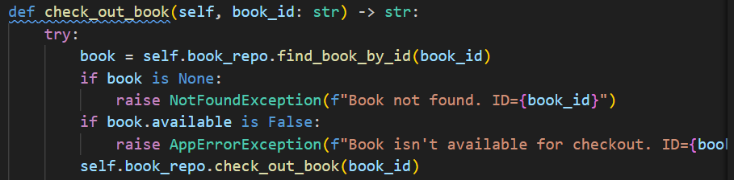
Exceptions
Custom Exceptions in src/domain/exceptions.py:
The service layer is responsible for checking and handling known business exceptions, NOT DOMAIN

Slide 29
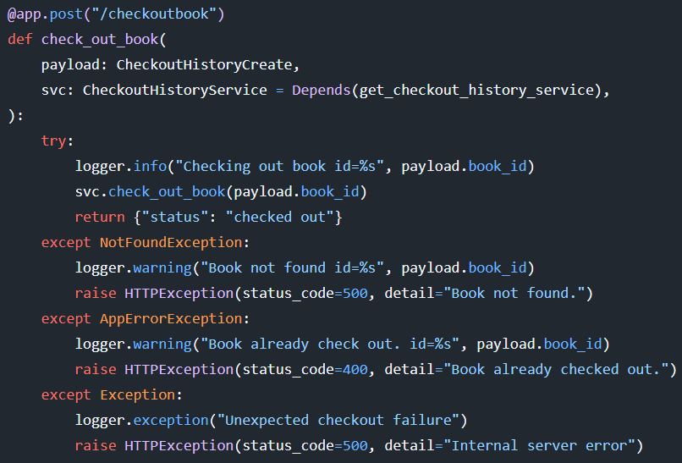
FastAPI HTTPExceptions
The service layer throws exceptions if needed
These are caught here at our endpoint and then:
      Logged
      HTTPException is raised… but how is it handled? FastAPI Global Exception Handlers!

Slide 30
FastAPI Global Exception Handlers
ORDER MATTERS – HTTPException handler is DECLARED FIRST in main.py. MORE SPECIFIC > MORE GENERAL
This catches all the HTTPExceptions we raise, and handles it:
This catches all UNEXPECTED and UNKNOWN exceptions:
@app.exception_handler(HTTPException)
async def http_exception_handler(request: Request, exc: HTTPException):
logger.exception("HTTP Exception occurred.")
return JSONResponse(
status_code=exc.status_code,
# safe to return detail here - this is intentional
content={"detail": exc.detail},
)
@app.exception_handler(Exception)
async def global_exception_handler(request: Request, exc: Exception):
logger.exception("Unhandled exception")
return JSONResponse(
status_code=500,
# here we give a vague message; we are NOT exposing execution details to the client
content={"detail": "Internal server error"},
)

